Slide 1
SMART Home
Group 2:
John Satterla – Computer Engineer – Wireless Connectivity
Zachary Eakerns – Electrical Engineer – Biomedical Station
Zarka McClung – Computer Engineer – Facial Recognition
Christian Jensen [Team Lead] – Electrical Engineer – Voice Recognition

Slide 2
Project Description
Our system will monitor a patient's position, and the environment around them will react to their movements. A station will be located in the home to monitor and display the user’s electrocardiogram . The “room” will have 2 major appliances that are activated via facial or voice recognition. Lights and other items will turn on as the user moves throughout the “room”. There will be a door that is automatically opened when the user is trying to enter the room.​

Slide 3
Responsibilities
John
Location detection
Wireless communication with Zigbee
Graphical user interface
Device control/interfacing in model house Zarka
Christian
Voice recognition
PCB desig Zach
EKG circuitry
Biomedical Station
Model House Construction
Facial Recognition
Serial Communication
Stepper Motor for door

Slide 4
Safety
Always wear appropriate PPE
Careful of short circuits, set current limits on power supplies when testing circuits
Make sure to have common ground

Slide 5








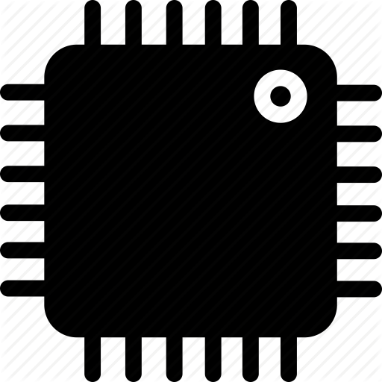




System Overview
Door can be opened automatically via facial recognition or control from central processing station via Zigbee
Portable Location Detection Device
Stepper motor to represent washer
Portable BLE Time of Flight device reacts to movements of user throughout the room and devices turn on inside the small scale model
LCD screen represents TV
LEDs to represent Lights
Full size automatic door with facial recognition
Computer fan to represent ceiling fan
PCB controls model’s devices
Small Scale House Model
Bluetooth Communication
Bluetooth ToF Beacon
Biomedical station gets EKG, heart rate, and blood oxygenation of the user, relays information to the Central processing station via Bluetooth.
Central processing station (computer) displays system information, EKG readings, and can control devices via voice commands. Communicates with rest of devices via Zigbee
Zigbee Module
MSP430 Microcontroller
Central processing Station, with Voice Recognition
Biomedical Station
John Satterla

Slide 6
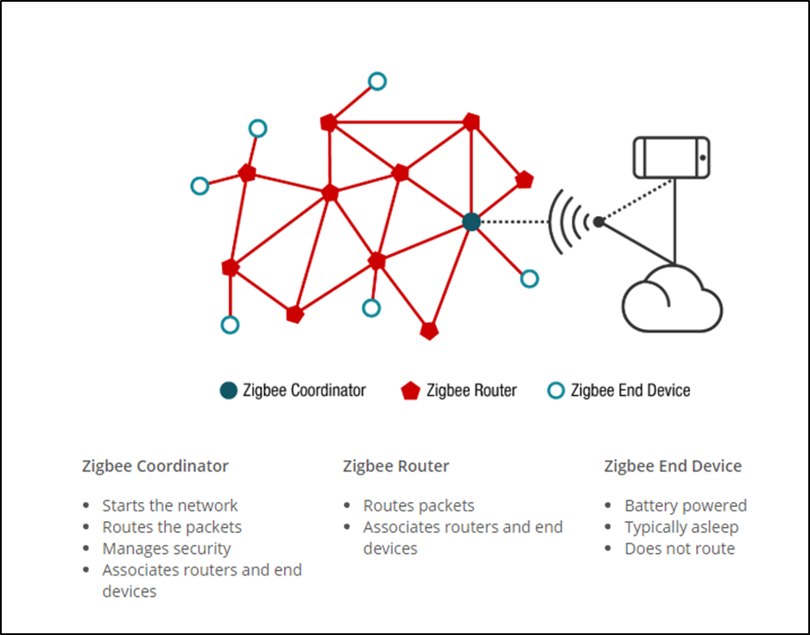
Smart Home Communication via Zigbee
Zigbee
Chosen because not sending much data other than characters to control devices (Zigbee data rate is 250kbps), Bluetooth would be overkill and not accomplish a true “mesh network”
Mesh networking allows for devices other than the coordinator (plugged into main computer) to join and leave the network, without problems thanks to automatic routing configuration built into the Zigbee specification
Long range – XBee modules from Digi support ranges up to 100m line of sight
Zigbee Network Example Topology [14]

Slide 7
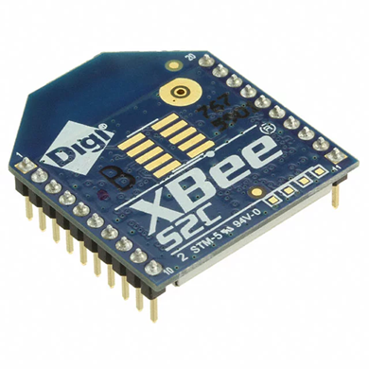
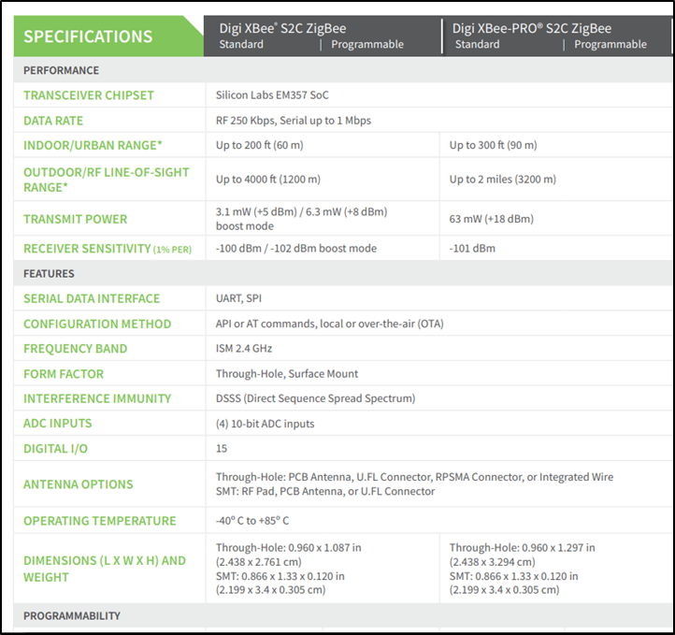
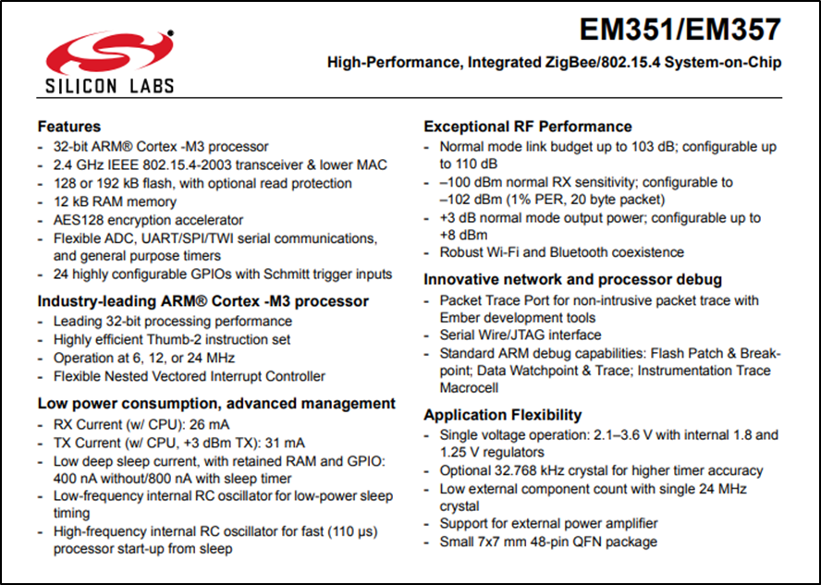
Smart Home Communication via Zigbee
XBee Modules from Digi
Uses Silicon Labs EM357 Zigbee SoC from Silicon Labs
Run Zigbee Pro 2007 (current spec is 3.0)
Communicate with two MSP430’s on green-board via UART, with computer via UART with RS-232 adapter
[2]
[4]

Slide 8
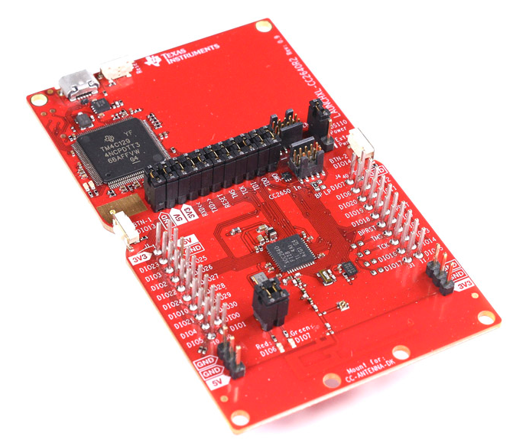
Location Monitoring of Patient
Bluetooth Time of Flight Program run on 2 TI CC2640R2F LaunchPads
Specs of CC2640R2F:
32-bit ARM Cortex M3 @ 48-MHz
28kB SRAM
128kB flash
PCB antenna on LaunchPad
[13]

Slide 9
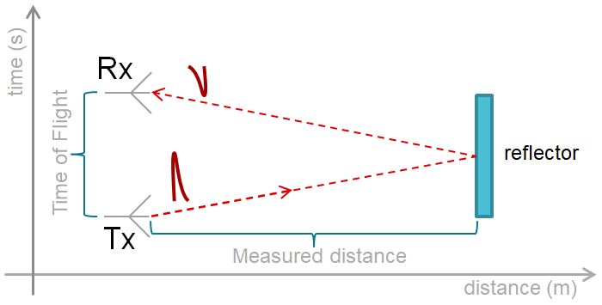
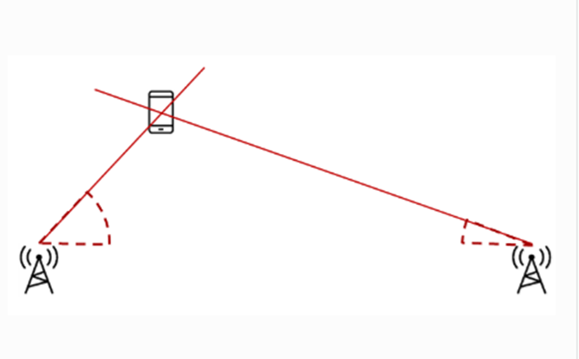
Location Monitoring of Patient
Bluetooth Time of Flight program sends packets from ‘initiator’ to the ‘responder’ and measures the time and RSSI (received signal strength indication) for each packet, then estimates the distance between the initiator and the responder
[1]

Slide 10
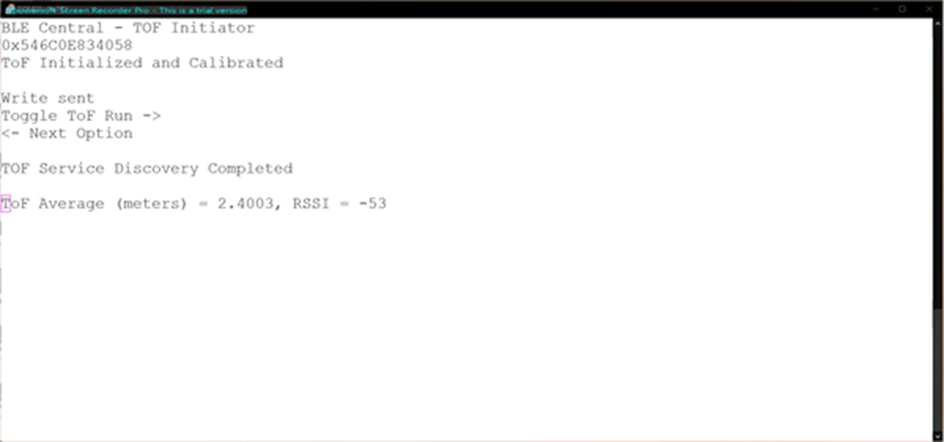
Location Monitoring of Patient
Bluetooth Time of Flight program sends packets from ‘initiator’ to the ‘responder’ and measures the time and RSSI (received signal strength indication) for each packet, then estimates the difference distance the initiator and the responder
Raw ToF output

Slide 11
Location Monitoring of Patient – Post Processing
Accuracy of ToF
Calibration has to occur each time the program starts, with each LaunchPad 1 meter away
Within 1-2m for each ToF measurement taken, giving me the 3-4m intervals for each “room”
Post distance processing algorithm in Python:
1. Take each measurement and place into an array of 10 measurements (first in, first out), call this measurementArray
2. Take the average of the measurementArray
3. Add this average to another array of 10 previous averages called averageArray, also (first in, first out)
4. Take the average of the last 10 averages (basically last 100 measurements taken)
5. Send the averaged value to the checkLocation function

Slide 12
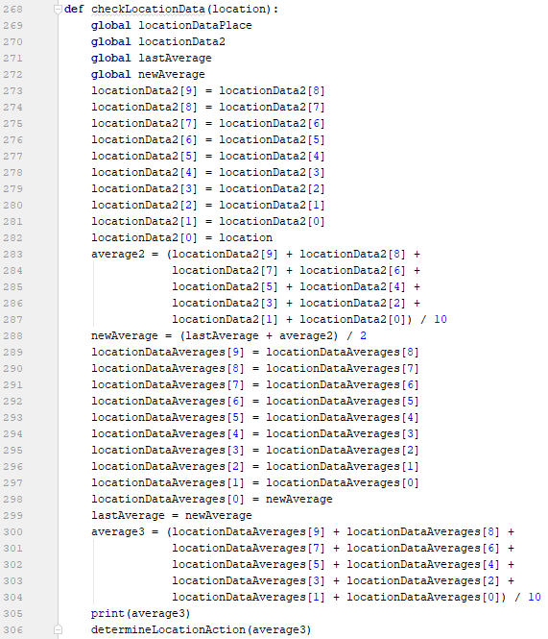
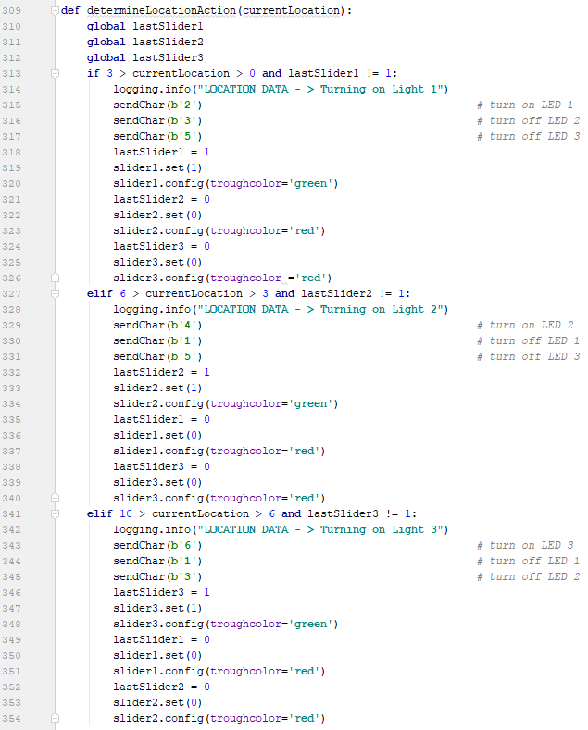
Location Detection – Processing in Python

Slide 13
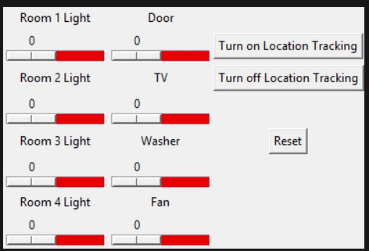
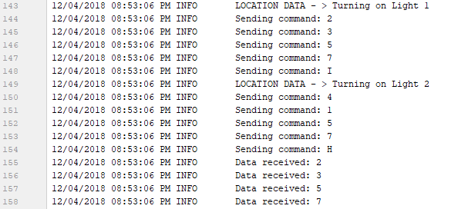
Graphical User Interface
Using Python 3, with TkInter as GUI, and pyserial for communication to USB dongle with XBee module and CC2640R2F LaunchPad
Added logging so we can debug somewhere other than the command line, and logging will also be useful for users
Current GUI for Control and monitoring of devices
Logging to aid debugging

Slide 14
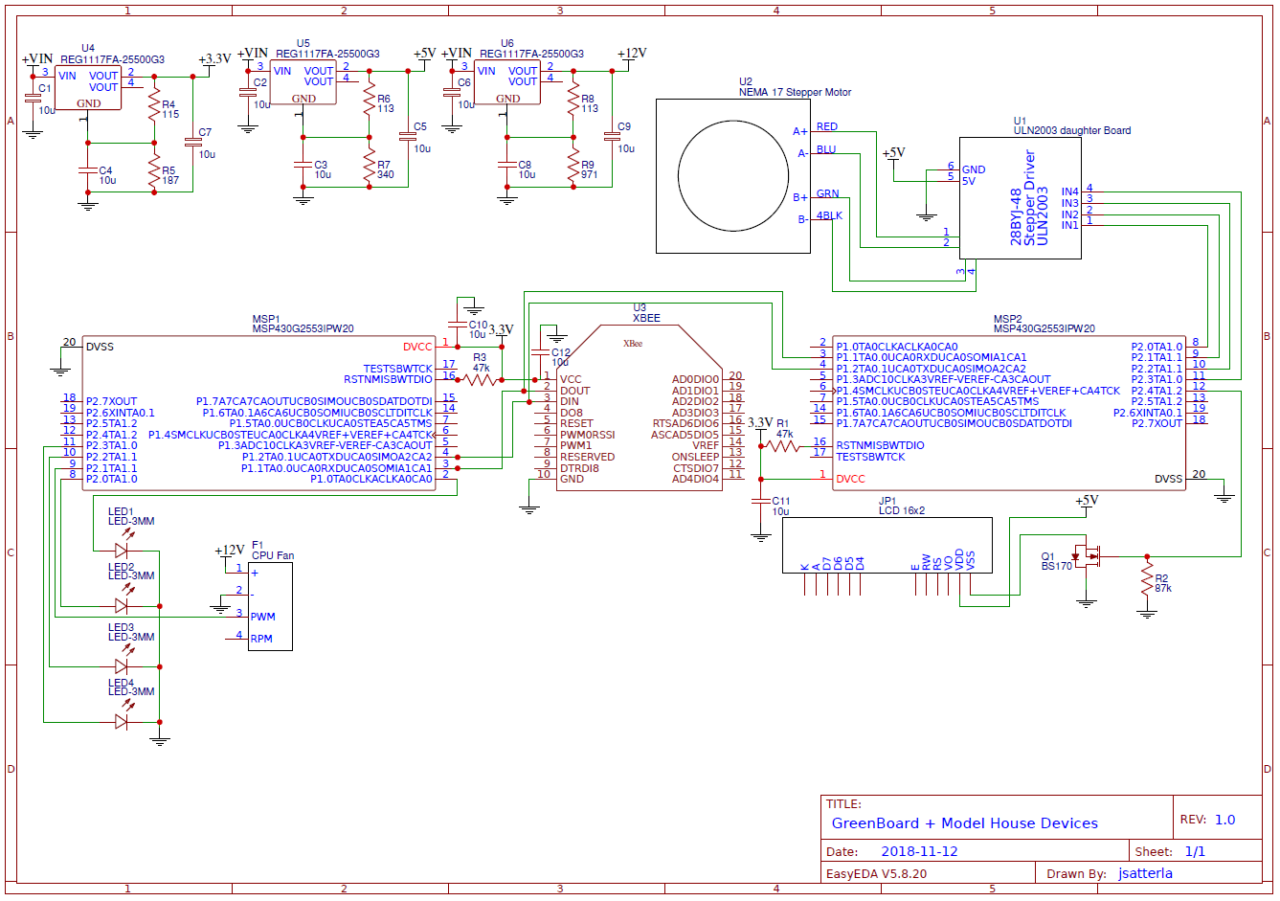
Devices – Model House Schematic

Slide 15
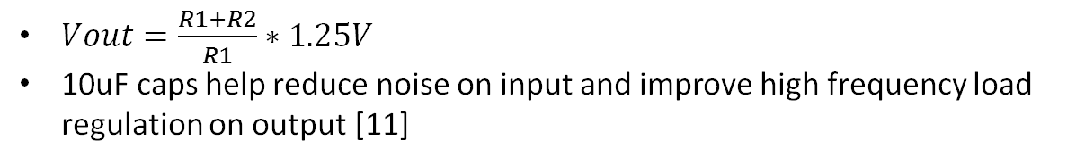
Devices – Model House Schematic
$Vout=\frac{R1+R2}{R1}∗1.25V$
10uF caps help reduce noise on input and improve high frequency load regulation on output [11]

Slide 16
Devices – Model House Schematic
PWM for fan on P2.1 (Timer A1 on MSP430)
87K pulldown on gate of BS170 so pin doesn’t float

Slide 17
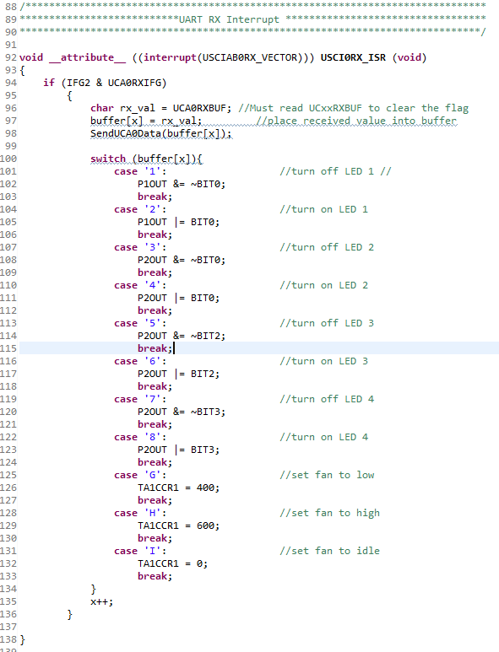
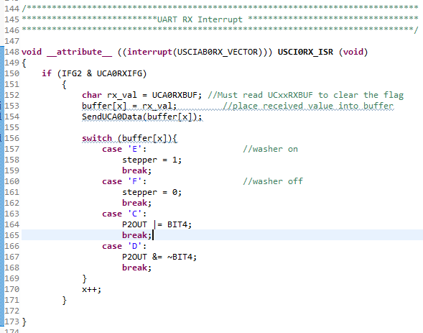
MSP430 Device Control Code
MSP #1
MSP #2

Slide 18
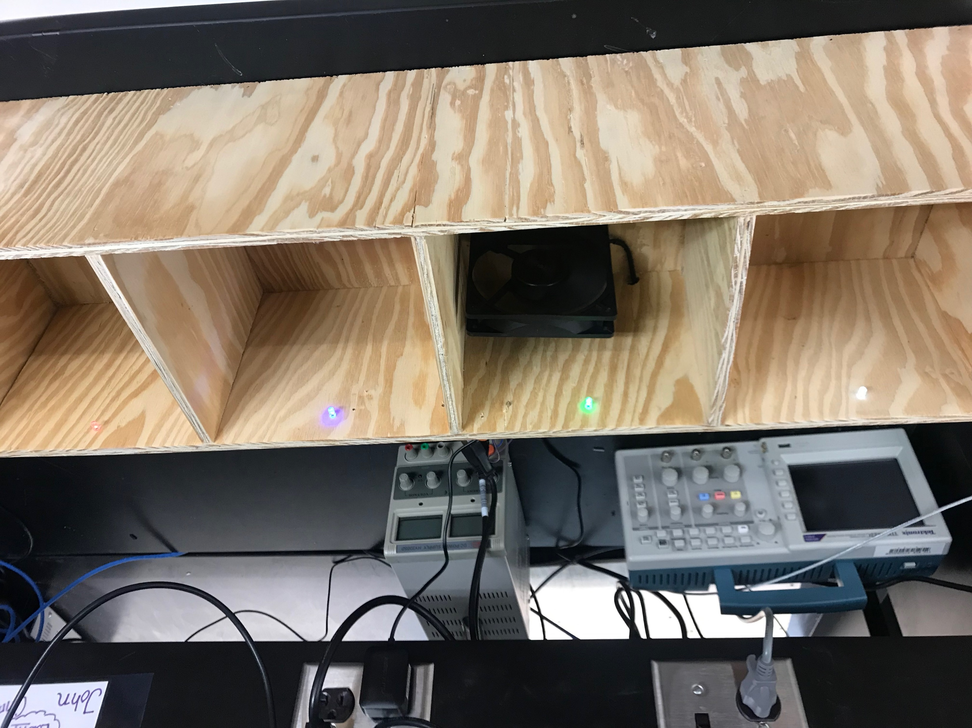
Model House with Devices
Washer
LEDs #1 - #4
Fan

Slide 19
GUI and Location Detection Program Demos
https://youtu.be/dGLGNG8CIQU – GUI manual control
https://youtu.be/VugtU7GQIsI- Location Detection
Notes:
https://youtu.be/ESfKke6Pie4

Slide 20
EKG Monitoring
Voltages ranging from 100 µV to 2 mV can be found across the chest due to the heart depolarizing and repolarizing
By amplifying and filtering these signals, an electrocardiogram can be made
By utilizing Python this data can be graphed and displayed in real time

Slide 21
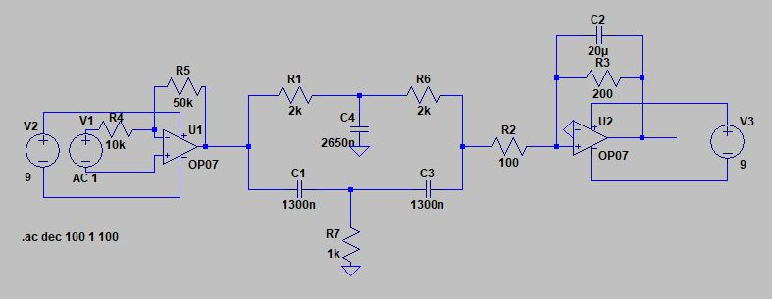
EKG Circuit Simulation

Slide 22
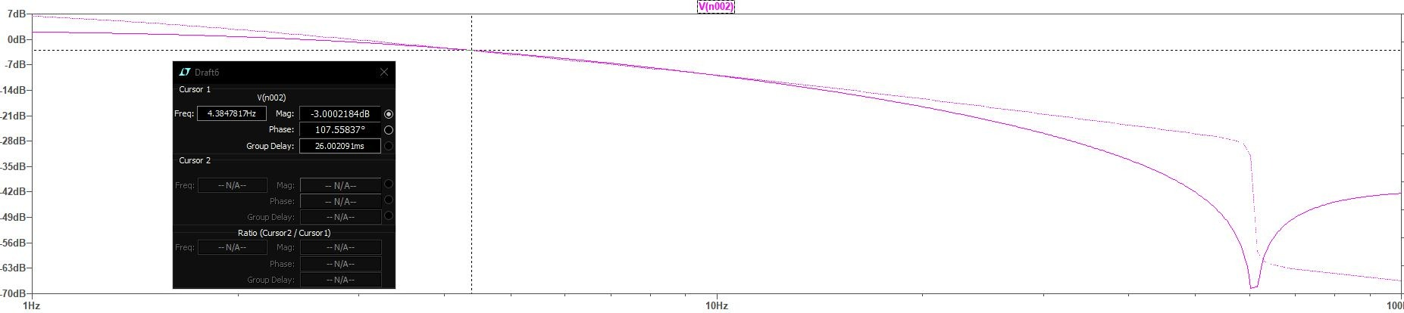
EKG Circuit Simulation Continued

Slide 23
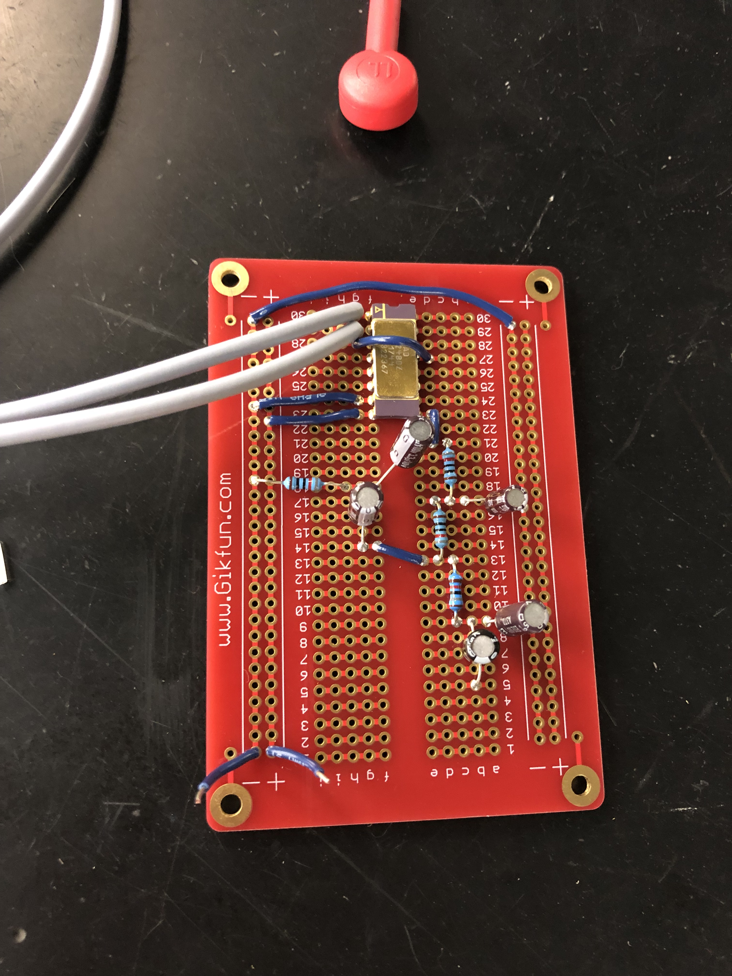

Slide 24
Code Composer Studio Code
Needed to control the MSP430G2553 microcontroller
This microcontroller was used for its ADC that would allow the voltages from the circuit to be graphed
The ADC10 allowed for a distinction of approximately 3 mV

Slide 25
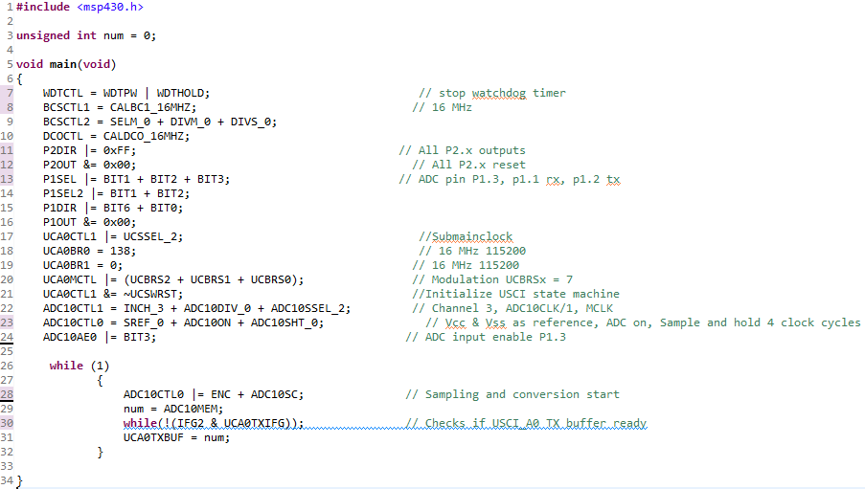

Slide 26
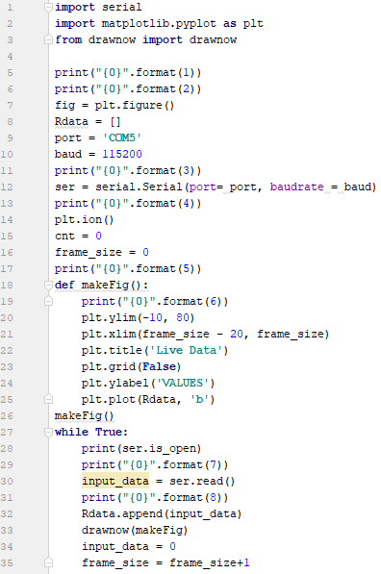
Python Code
Was used to graph data from ADC in real time
Used serial communication through Bluetooth with the aid of the BlueSMiRF chip

Slide 27
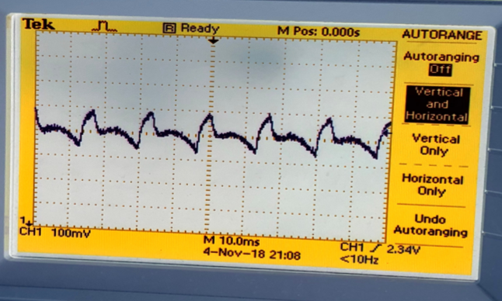
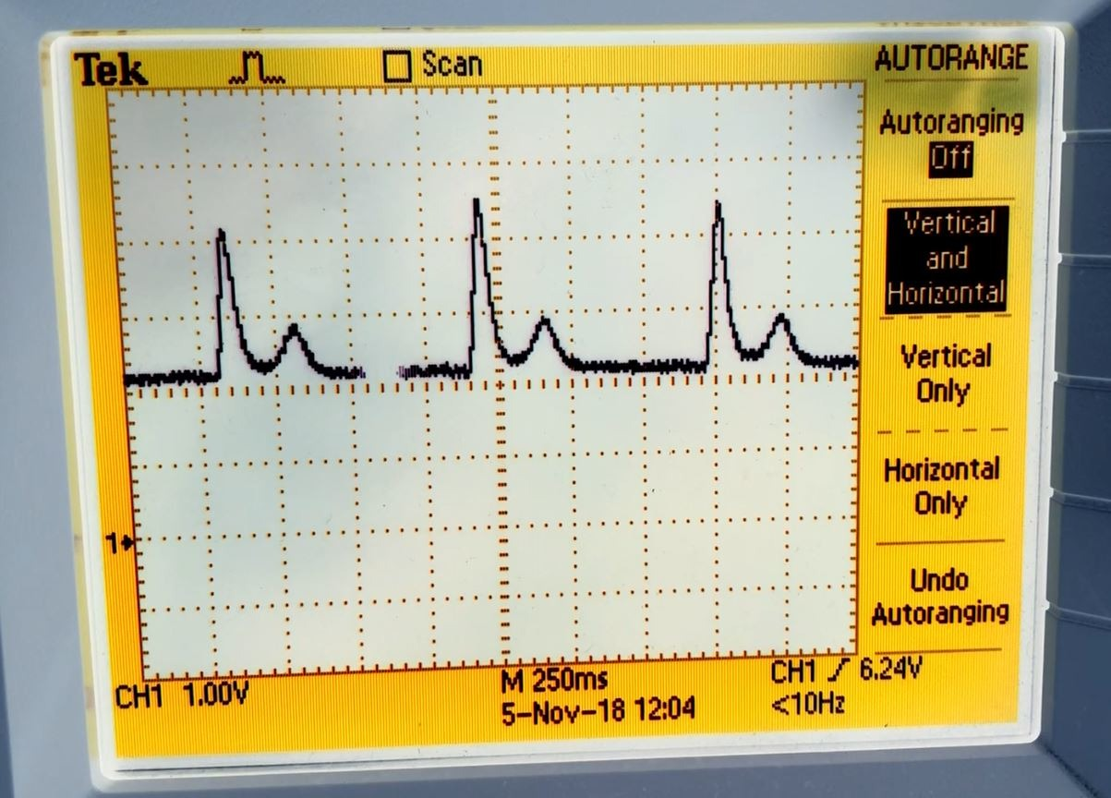
Results
With artifact
Without artifact

Slide 28
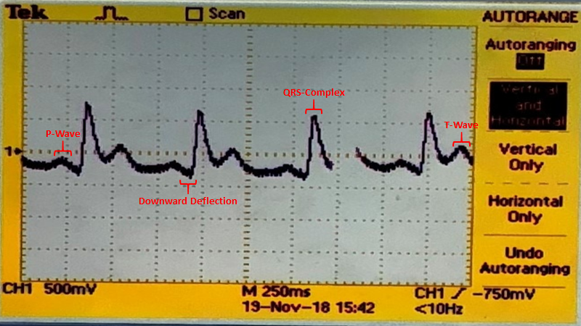
Zachary Eakerns

Slide 29
Video of EKG
https://www.youtube.com/watch?v=uSn0SAEYFiA

Slide 30
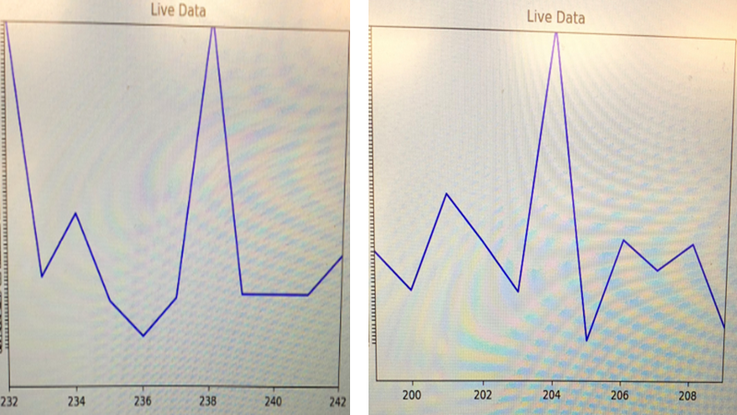
Zachary Eakerns

Slide 31
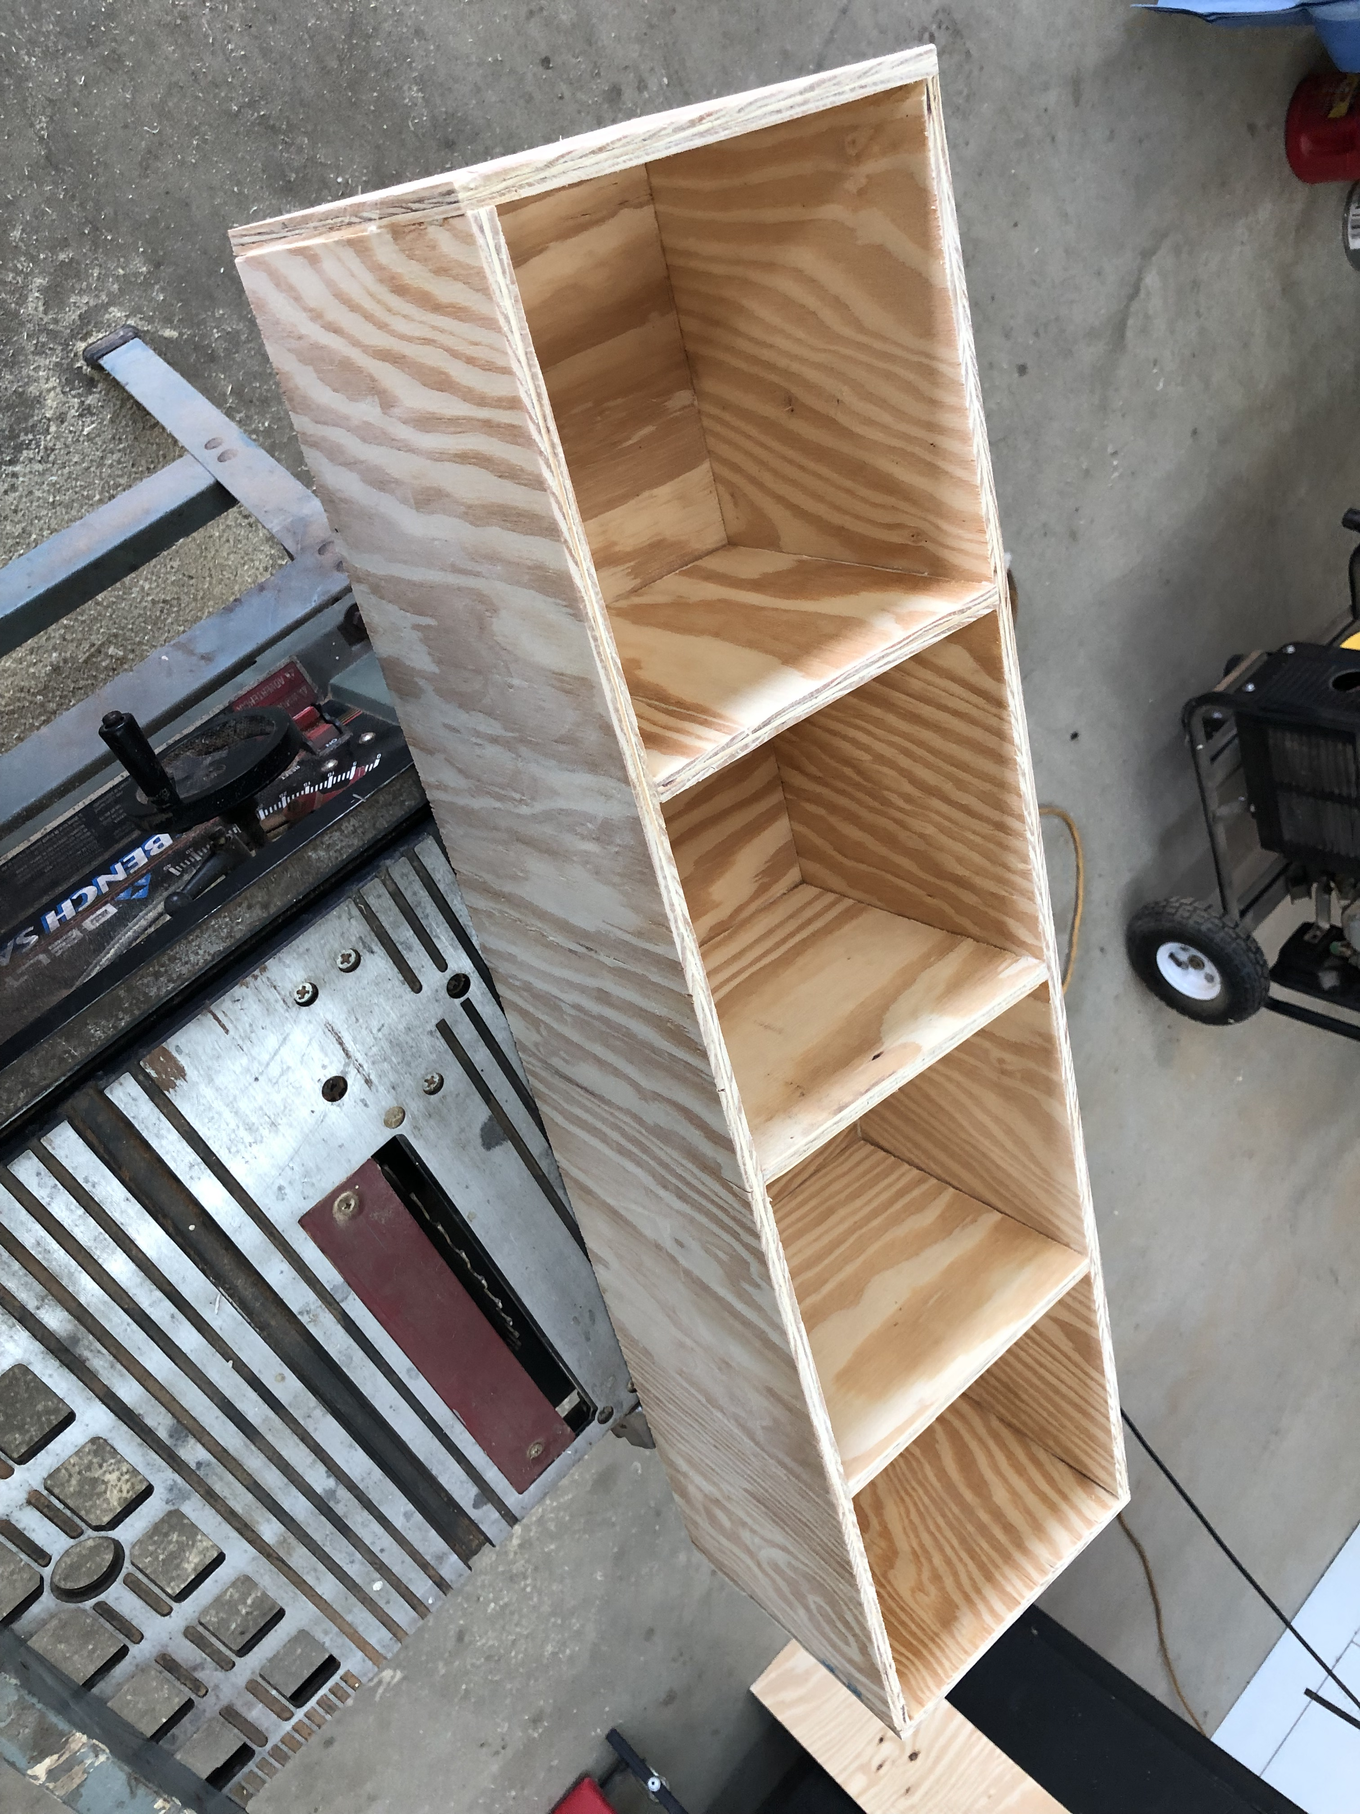
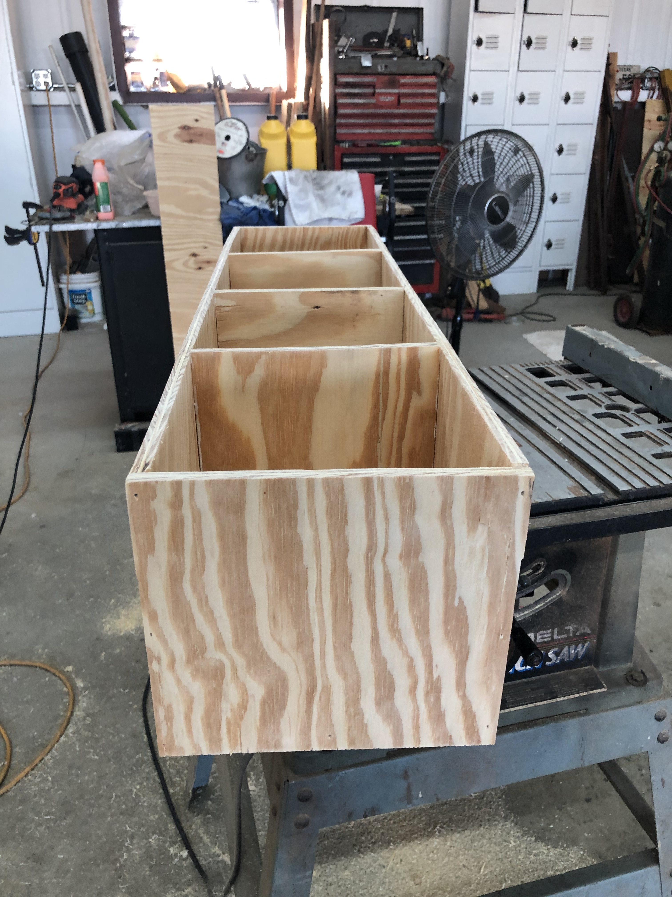
Zachary Eakerns

Slide 32
Voice Recognition
Done in Matlab
Using one outside toolbox – VoiceBox [7]
Using the []=melceps() function
Returns the cepstrum vector of the signal time vectors
Single user
Requires prerecording of specific phrases for detection

Slide 33
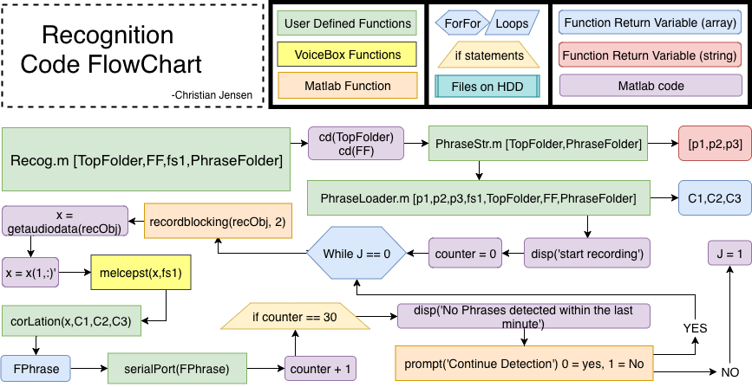

Slide 34
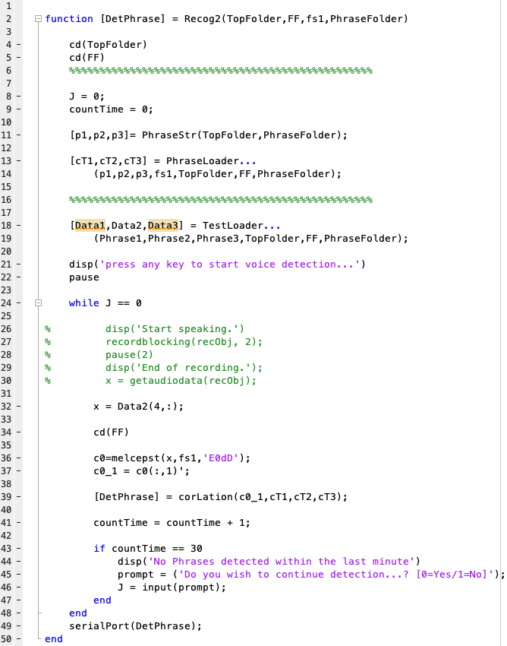

Slide 35
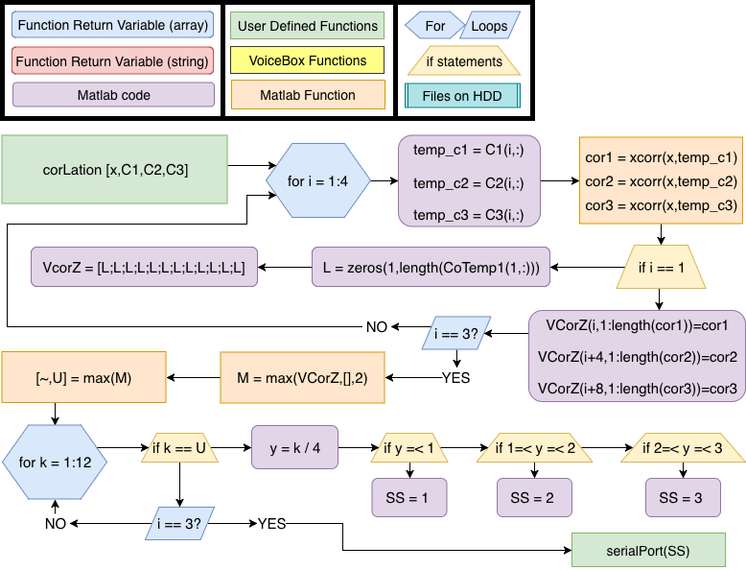

Slide 36
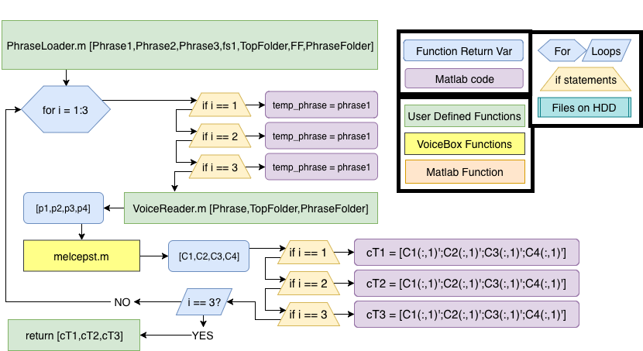

Slide 37
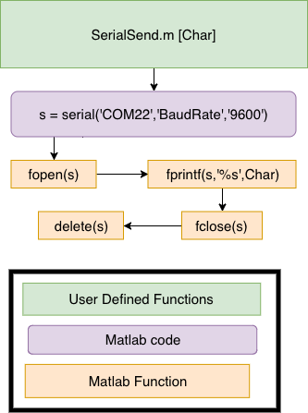
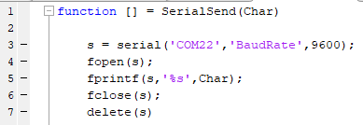

Slide 38
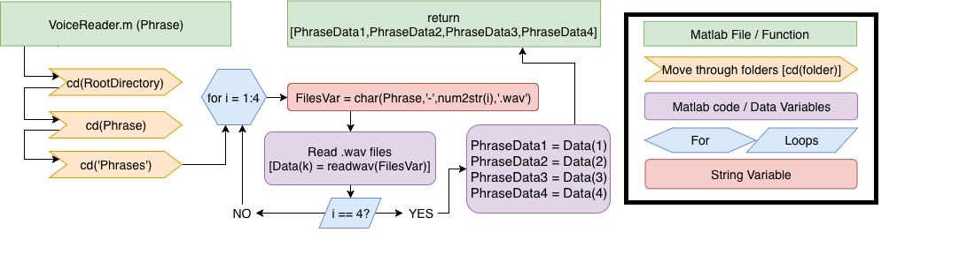
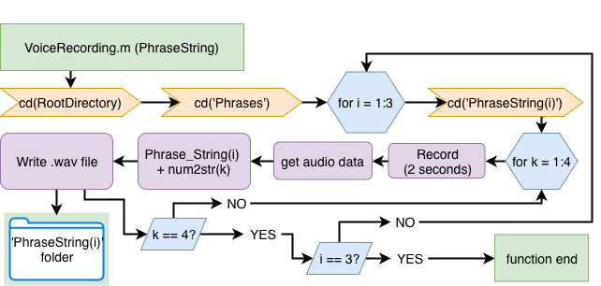

Slide 39
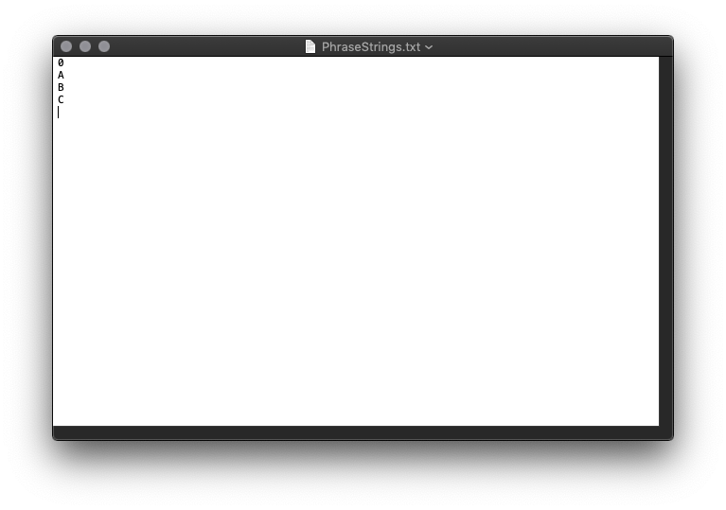
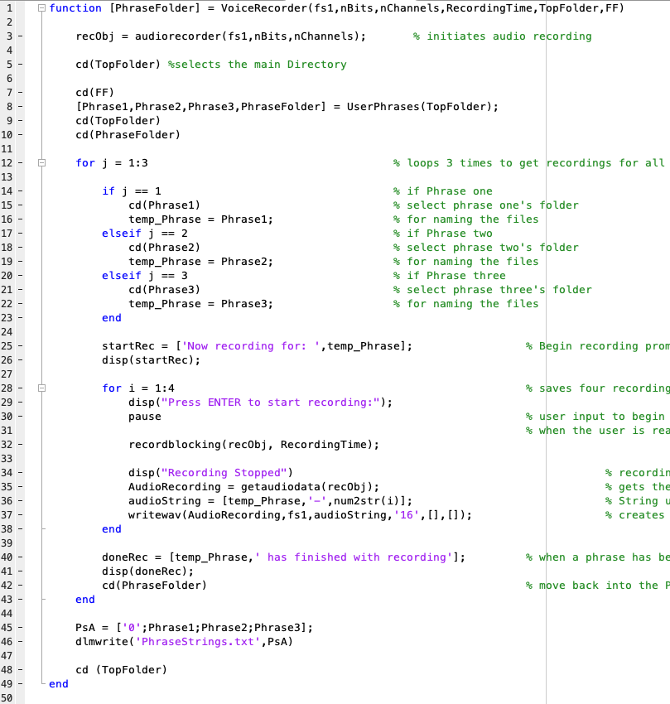
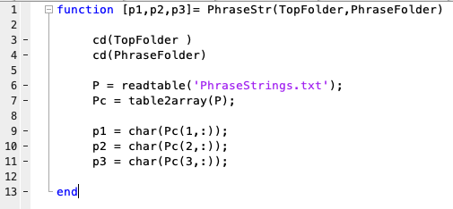
Phrase String Table example

Slide 40
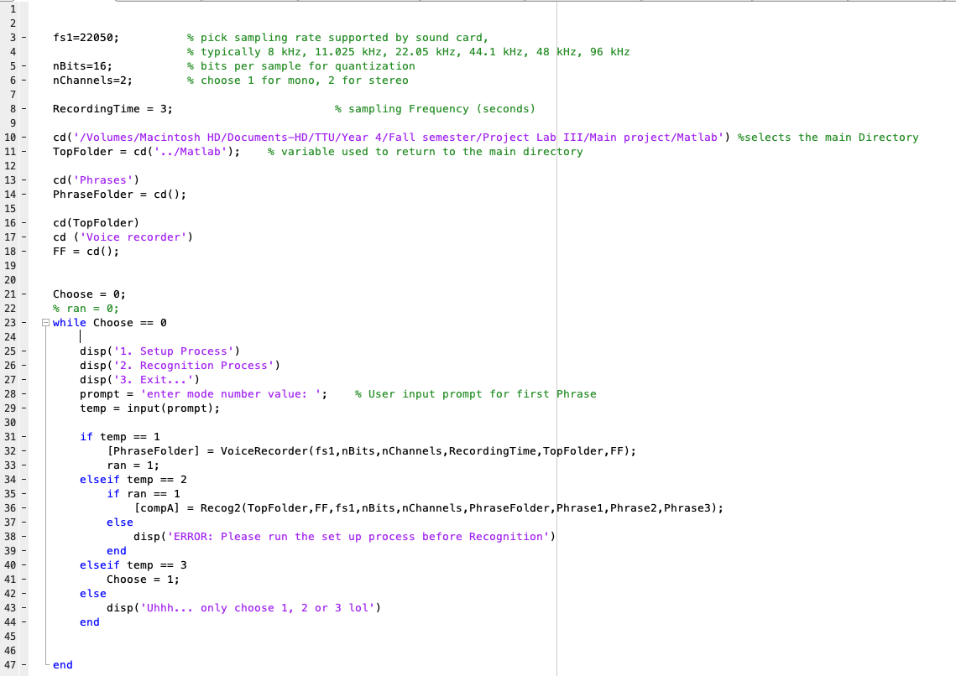

Slide 41
Demo Screen Recording of Recognition
https://youtu.be/yX46B4Bykhw

Slide 42
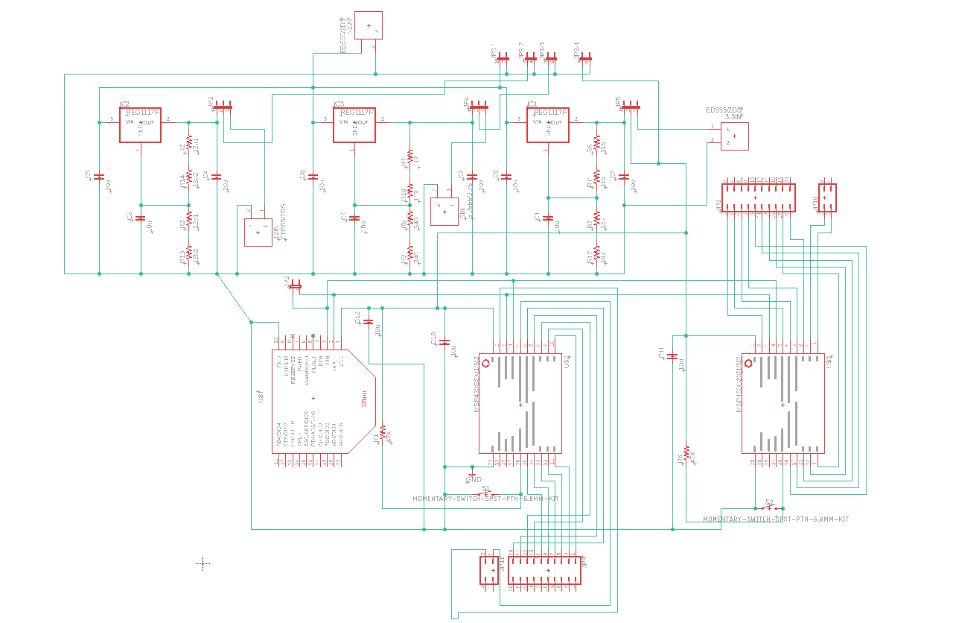
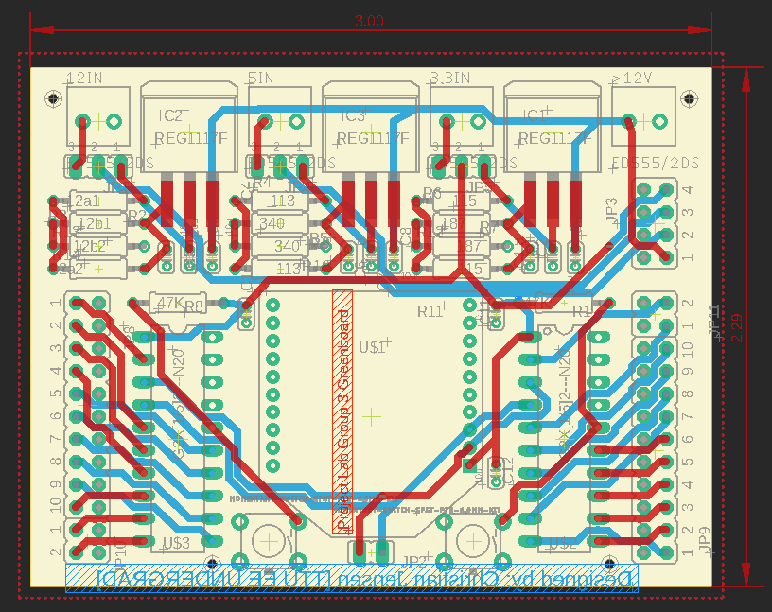
Green Board Design
2 MSP paired with an XBee Module
2x MSP430G IC
3x regulators
All REG1117 adjustable LDOs [1]
1 A output (max)
3.3V,5V,12V
XBee Module on header pins
Design done in Eagle Cad

Slide 44
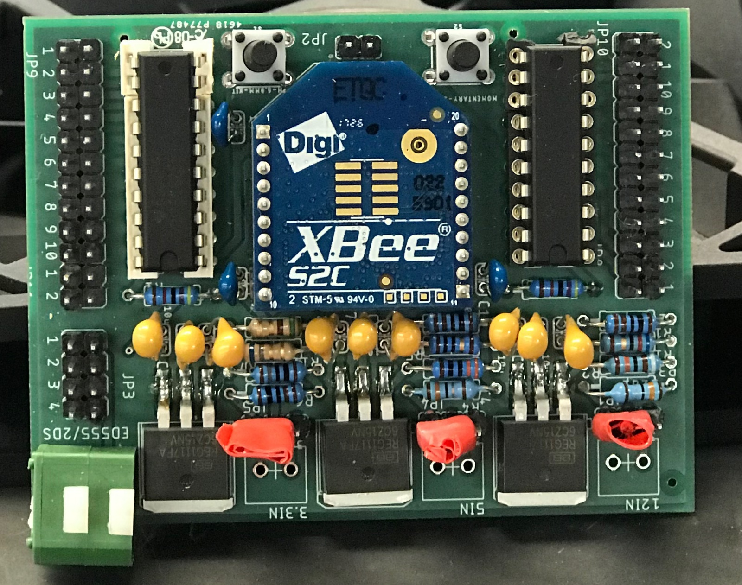

Slide 45
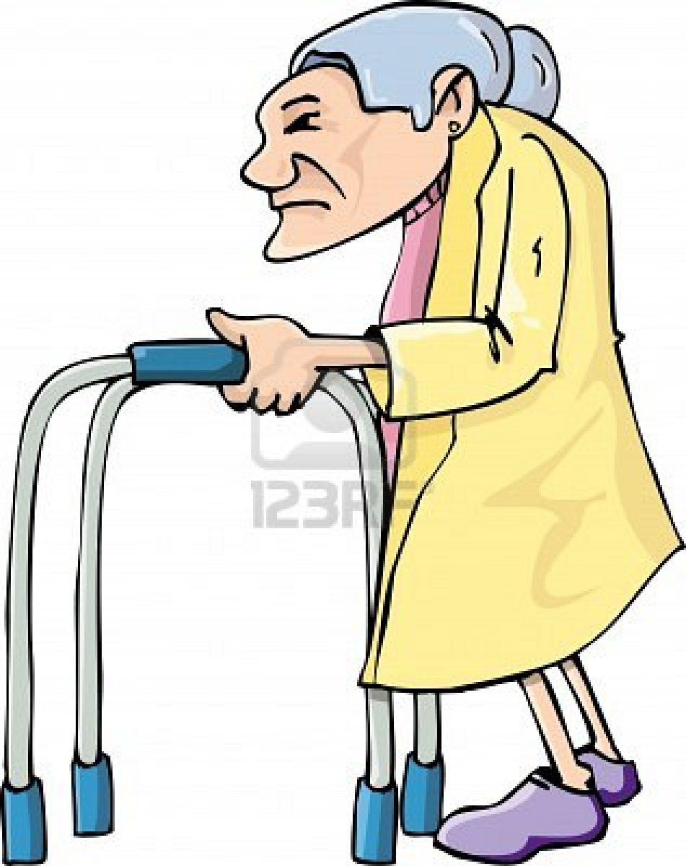
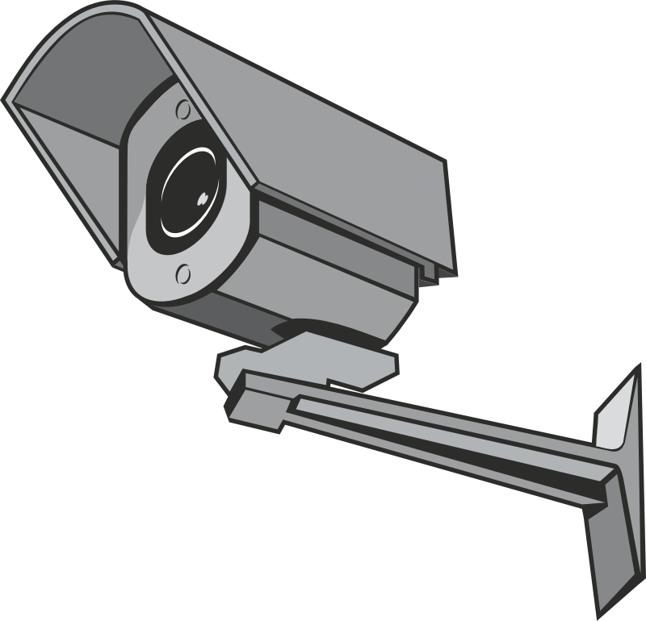
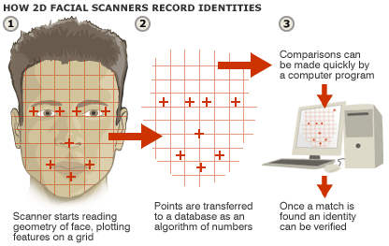
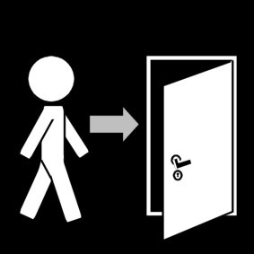
Face Recognition Using OpenCV v3.4 and Python v2.7
Goal: Detect recognized user’s face to open a door automatically.
This Photo by Unknown Author is licensed under CC BY-ND
This Photo by Unknown Author is licensed under CC BY-NC
This Photo by Unknown Author is licensed under CC BY-ND

Slide 46
Face Recognition Using OpenCV v3.4 and Python v2.7
Why use OpenCV computer vision library?
Free-to-use open source computer vision and machine learning software library (BSD license - minimal to no restrictions on the use of the library)
Can employ the code and tweak it as we want by adding copyright notice
Can access more than 2,500 algorithms using the library
Guided tutorials and documentation available
[8]
[9]

Slide 47
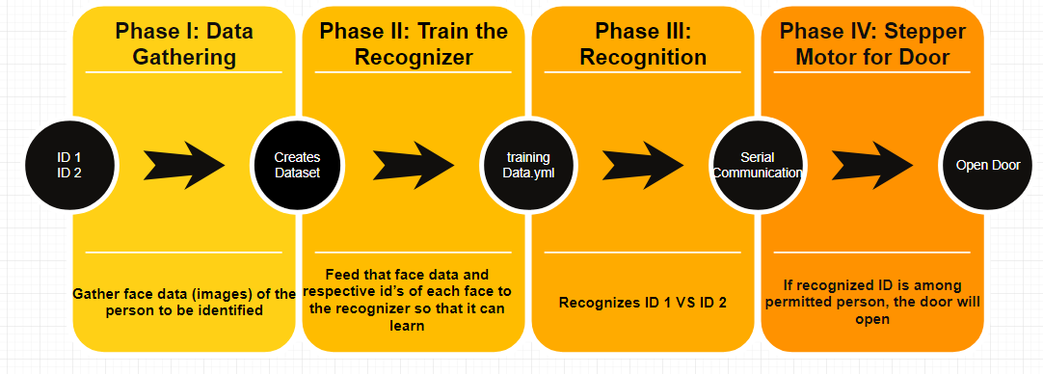
Phases of Face Recognition and Automatic Door

Slide 48
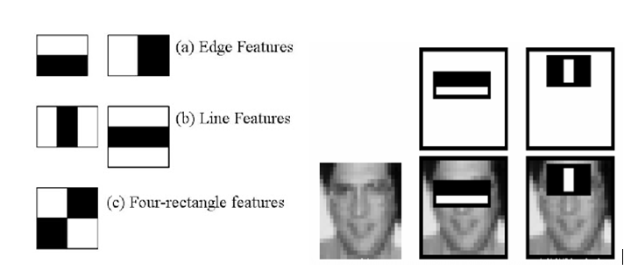
How different features are detected?
Each feature of the user is obtained by subtracting sum of pixels under the white rectangle from sum of pixels under black rectangle. For example, user’s nose area will have lighter shade compared to the eye area. So, the Haar feature uses black edges around the eyes, compared to white edges around the nose. [3]
To have minimum error, Haar features are added to all training images, which means more capture of user images will lead to least error and accurate classification.

Slide 49


Turning on webcam
Using Frontal face harcascade classifier
getting ID number
Assigning ID # to images
[5]
[10]
Collecting 1000 samples and getting out of the loop

Slide 50


Slide 51

Training the Recognizer
Each pixel of grayscale image is selected with its neighboring pixel surrounding the center pixel. Then a local binary pattern is generated for this center pixel and stored in the output 2D array [12]
LBP pattern histogram [Rosebrock, A.]
[12]
This method is used on all captured images to train the recognizer and stored in a trainingData.yml file.

Slide 52




Recognizer = LBPH (LOCAL BINARY PATTERNS HISTOGRAMS) Face Recognizer, included with OpenCV package
Join root path with image name to create list of all images
Converting PIL (python image library) images to gray scale & numpy array format
[5]
Converting integer array to numpy array for Ids

Slide 53


Provides a complete histogram and now we have trained the software using our userIDs

Slide 54


Recognition and Sending Serial Command
Importing trained yml file
Setting up COM port to send signal to Zigbee module
Setting high acceptance range for confidence level (0 = perfect match)
Sending char “A” to open the door when authorized user is detected
[5]​

Slide 55



Stepper motor door setup
NEMA 17 SM-42BYG011-25 stepper motor

Slide 56


Setting up variables and defining functions
Using 16MHz clock
To send signal door is closed

Slide 57

MSP430 motor code
Authorized user detected
Take enough steps to open the door
STEP -Logic Output. Triggers the motor to step forward one step.
DIR -Logic Output. Determines the direction of motor rotation.
Close the door
Send feedback to central monitoring system door is closed

Slide 58
Link of working facial recognition
https://www.youtube.com/watch?v=9QVIsDHt_aM

Slide 59
Power Budget
Part Name | Quantity | Supply Voltage (V) | Supply Current (mA) | Power Subtotal (W)
Lenovo E545 laptop | 1 | 20 | 3250 | 65
MSI GT72VR Laptop | 1 | 19.5 | 11800 | 230
MSP430G2553 | 2 | 3.3 | 0.42 | 1.4m
BlueSMiRF | 1 | 3.3 | 4 | 13.2 m
AD624 | 1 | 6 | 5 | 30 m
NEMA 17 stepper motor | 1 | 7.5 | 330 | 2.475

Slide 60



Gantt Chart

Slide 61

Gantt Chart

Slide 62

Budget

Slide 63

Material Cost

Slide 64
References
Dev.ti.com. (2018). Localization Toolbox — SimpleLink™ CC2640R2 BLE-Stack User's Guide for *Bluetooth®* 4.2 3.02.00.00 documentation. [online] Available at: http://dev.ti.com/tirex/content/simplelink_cc2640r2_sdk_2_20_00_49/docs/blestack/ble_user_guide/html/localization/index.html [Accessed 3 Oct. 2018].
DIGI XBEE® AND DIGI XBEE-PRO® ZIGBEE,” digi.com, 2018. [Online]. Available: https://www.digi.com/pdf/ds_xbee_zigbee.pdf. [Accessed: 25-Sep-2018].
Docs.opencv.org. (2018). OpenCV: Face Detection using Haar Cascades. [online] Available at: https://docs.opencv.org/3.4/d7/d8b/tutorial_py_face_detection.html [Accessed 26 Sep. 2018].
“EM351/EM357 High-Performance, Integrated ZigBee/802.15.4 System-on-Chip,” silabs.com, 2013. [Online]. Available: https://www.silabs.com/documents/public/data-sheets/EM35x.pdf. [Accessed: 25-Sep-2018].
“Face Recognition Using OpenCV,” The Codacus, 23-Jun-2017. [Online]. Available: https://thecodacus.com/face-recognition-loading-recognizer/#.W72PXGhKjIU. [Accessed: 10-Oct-2018].
K, T. (2018). Easy Driver Hook-up Guide. [online] Available at: https://learn.sparkfun.com/tutorials/easy-driver-hook-up-guide [Accessed 14 Nov. 2018].
M. Brooks, “VOICEBOX: Speech Processing Toolbox for MATLAB,” Description of fxpefac. [Online]. Available: http://www.ee.ic.ac.uk/hp/staff/dmb/voicebox/voicebox.html#sigproc. [Accessed: 10-Oct-2018].]
“OpenCV library,” About - OpenCV library. [Online]. Available: https://opencv.org/. [Accessed: 10-Oct-2018].
“OpenCV Reviews: Overview, Pricing and Features,” Financesonline.com. [Online]. Available: https://reviews.financesonline.com/p/opencv/. [Accessed: 10-Oct-2018].
“OpenCV: Core functionality,” Cascade Classification - OpenCV 2.4.13.7 documentation. [Online]. Available: https://docs.opencv.org/3.4/d0/de1/group__core.html#ga0f9314ea6e35f99bb23f29567fc16e11. [Accessed: 10-Oct-2018].
“REG1117A (ACTIVE),” REG1117A 1A Low Dropout Positive Regulator | TI.com. [Online]. Available: http://www.ti.com/product/REG1117A. [Accessed: 07-Nov-2018].
Rosebrock, A. (2018). Local Binary Patterns with Python & OpenCV - PyImageSearch. [online] PyImageSearch. Available at: https://www.pyimagesearch.com/2015/12/07/local-binary-patterns-with-python-opencv/ [Accessed 24 Oct. 2018].
“SimpleLink Bluetooth® low energy CC2640R2F wireless MCU LaunchPad development kit,” LM741 Operational Amplifier | TI.com. [Online]. Available: http://www.ti.com/tool/LAUNCHXL-CC2640R2. [Accessed: 05-Dec-2018].
Zigbee Network Example Topology [“Zigbee | Overview | Wireless Connectivity,” SimpleLinkTM Zigbee Wireless MCUs, 2018. [Online]. Available: http://www.ti.com/wireless-connectivity/simplelink-solutions/zigbee/overview.html. [Accessed: 26-Sep-2018].

Slide 65
Questions?

Slide 66
All videos
https://youtu.be/dGLGNG8CIQU – GUI manual control
https://youtu.be/VugtU7GQIsI - Location Detection
https://www.youtube.com/watch?v=uSn0SAEYFiA – EKG
Demo Screen Recording of Recognition – MatLAB voice recog.
https://www.youtube.com/watch?v=9QVIsDHt_aM – facial recog.

